Slide 1
ST. THOMAS’ (Autonomous) COLLEGE Thrissur
DEPARTMENT OF PHYSICAL EDUCATION
ACHIVEMENTS 2017-18

Slide 2
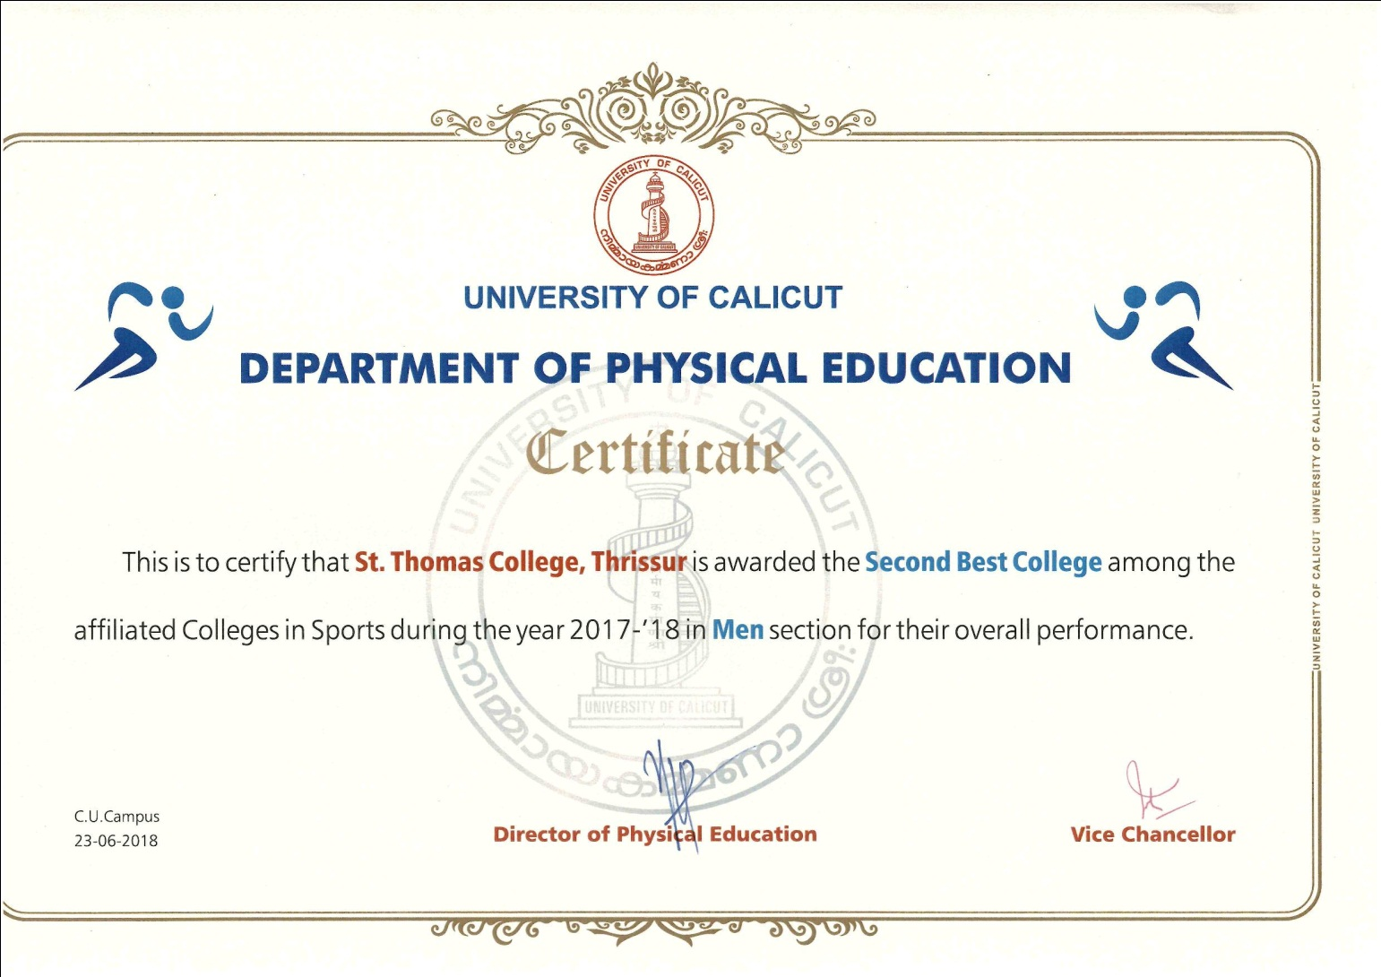
St.Thomas College Awarded the Second Best College Among the Affiliated Colleges in Sports During the Year 2017-18 in Men Section for the Overall Performance

Slide 3
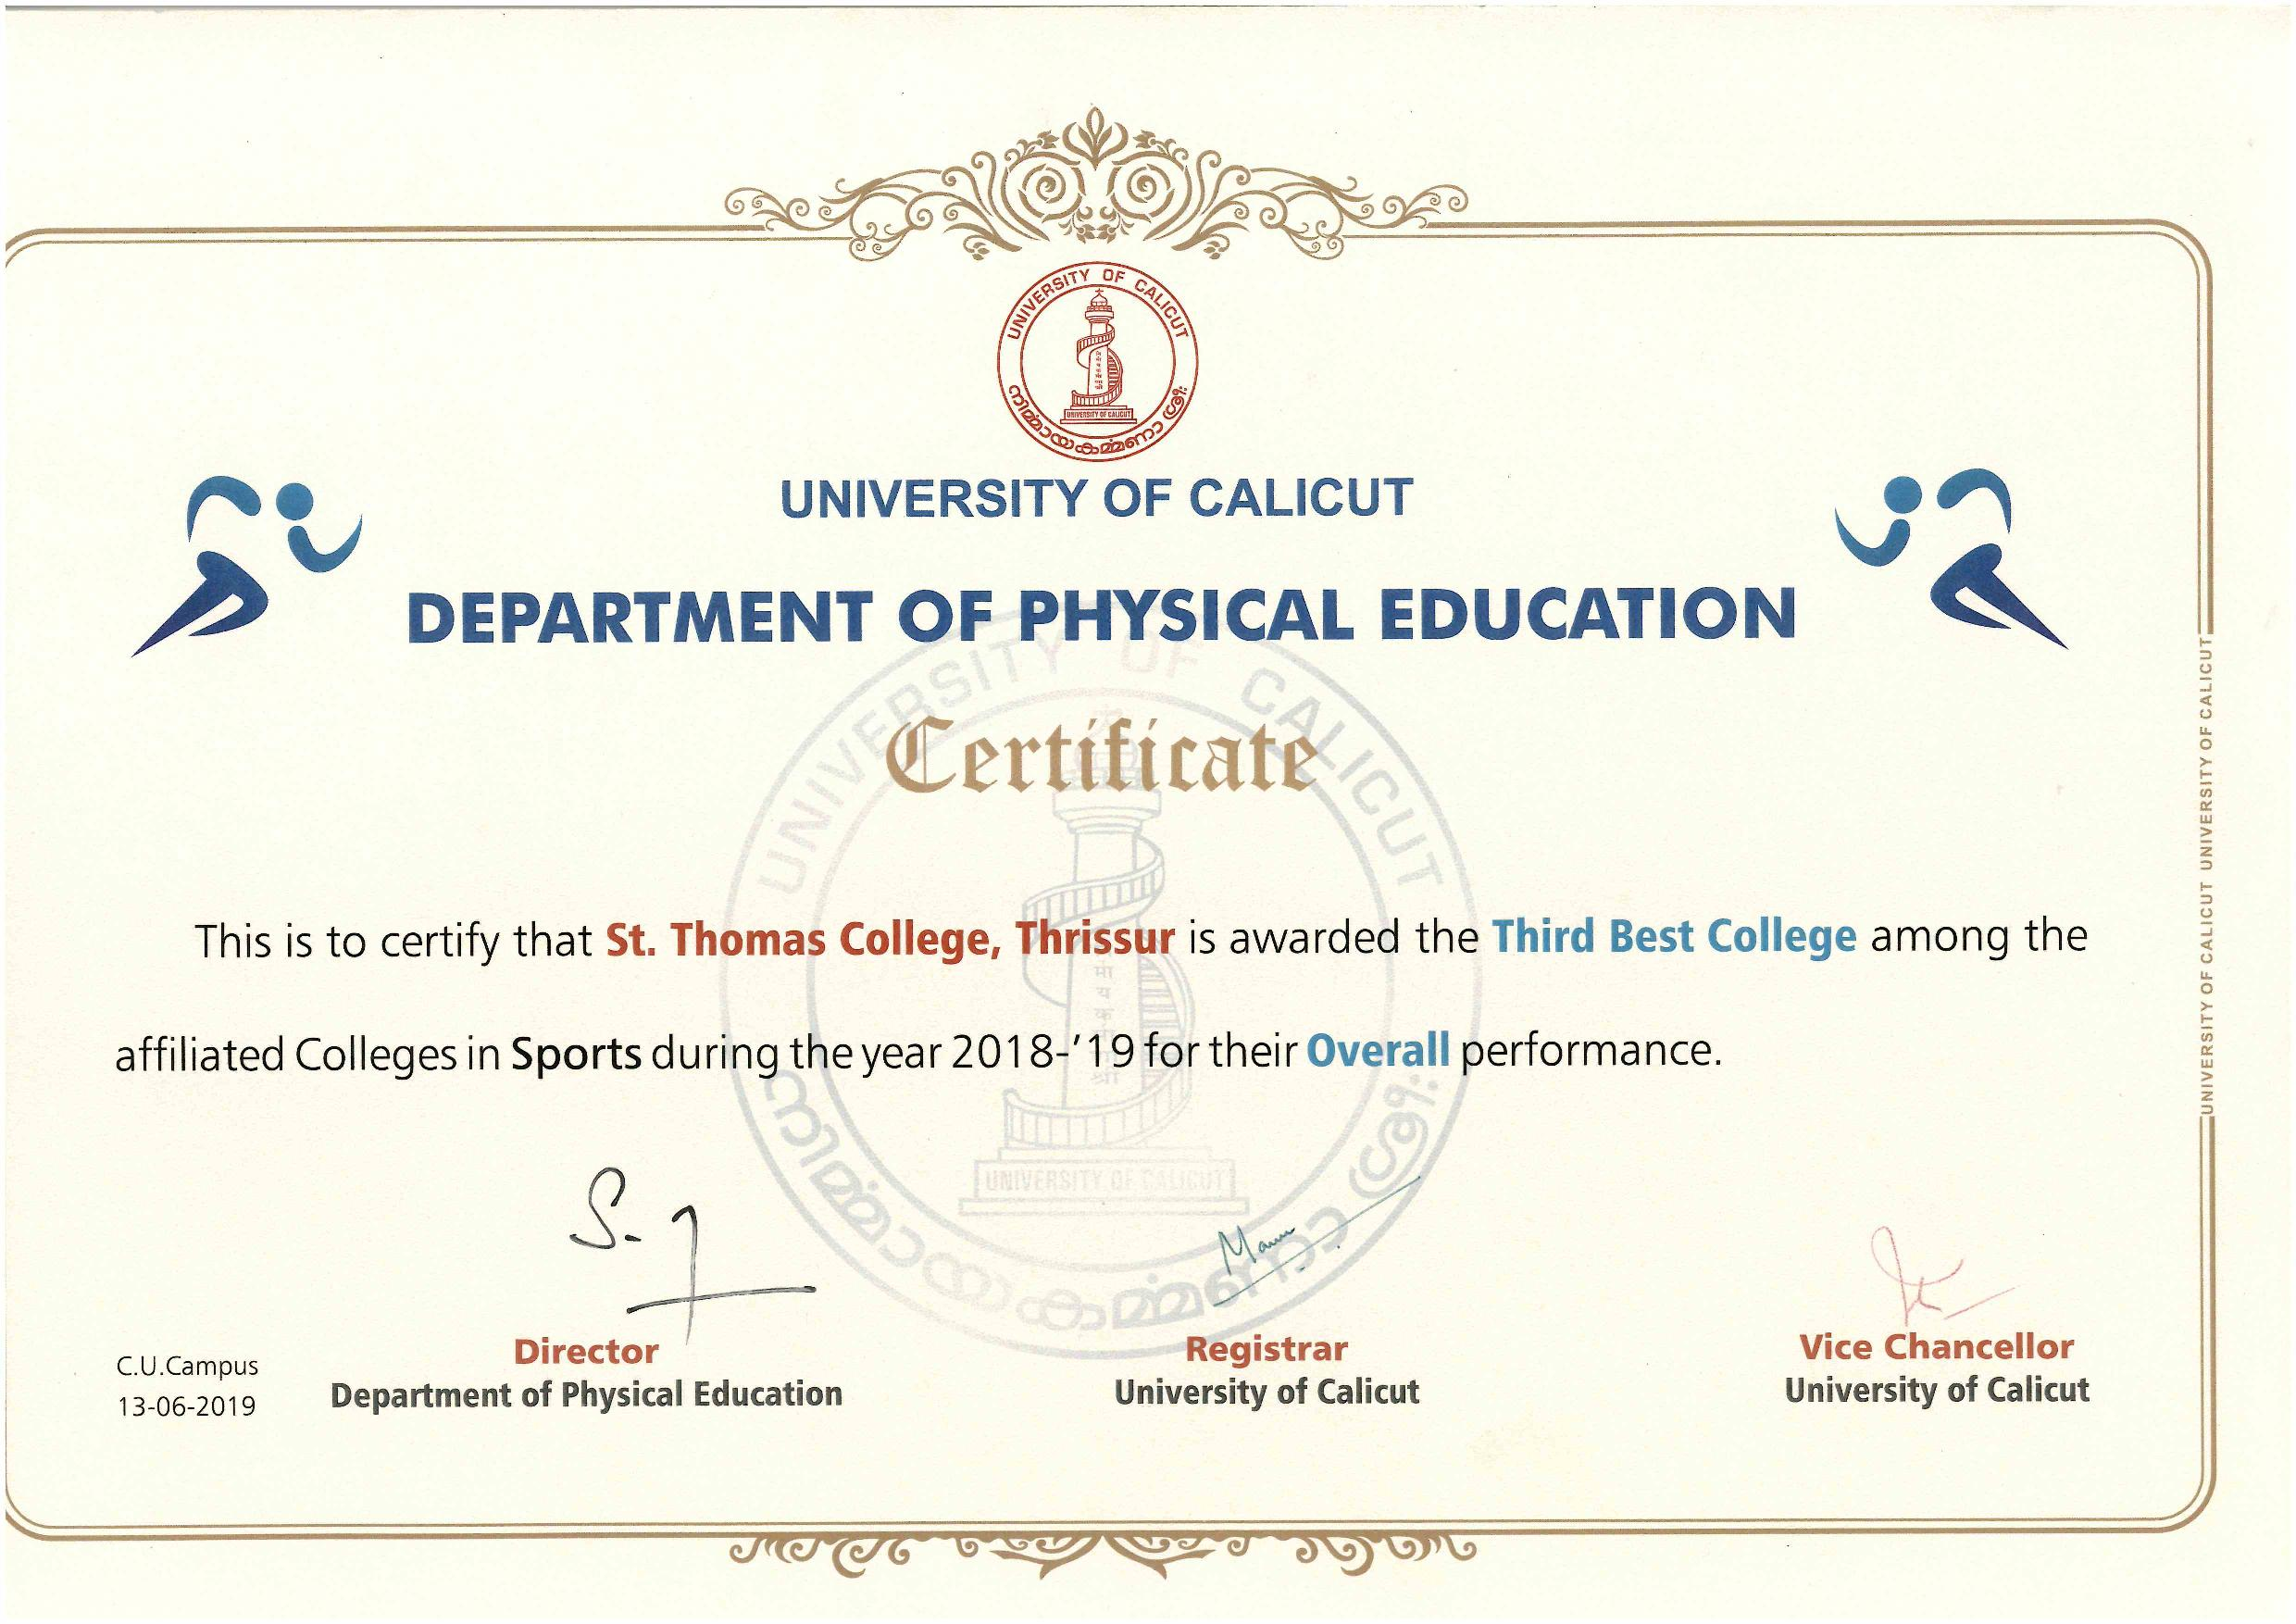
St.Thomas College Awarded the Third Best College Among the Affiliated Colleges in Sports During the Year 2017-18 for the Overall Performance

Slide 4
INTERNATIONAL COMPETITIONS 2017-18
SL NO: | NAME | VENUE OF CHAMPIONSHIP | EVENT
1 | SIBIN VARGHESE | RUSSIA | WATERPOLO
2 | MIDHUN A J | RUSSIA | WATERPOLO
3 | JISMI P.A . | SREE LANKA | YOGA
4 | Gauwtham P.B. | NEPAL | BOXING

Slide 5
TEAM CHAMPIONSHIPS 2018-19 CALICUT UNIVERSITY TEAM CHAMPIONSHIPS
(FIRST)
CHESS
CYCLING
BOXING
FENCING
HOCKEY
POWERLIFTING
WEIGHTLIFTING
(SECOND)
SWIMMING
WATERPOLO
CRICKET
YOGASANA
(THIRD)
ATHLETICS
ARCHERY – COMPOUND
D-ZONE CHAMPIONSHIPS (MEN)
FOOTBALL FIRST

Slide 6
NATIONAL UNIVERSITY (ALL INDIA) POSITIONS2017-18
SL.NO: | NAME | EVENT |  | POSITION
1 | Maymon Poulose | 110 MTR HURDLES | ALL INDIA IUT | GOLD (RECORD)
2 | SREEKUTTAN V S | FOOTBALL | ALL INDIA IUT | GOLD
3 | SAJITH K S | FOOTBALL | ALL INDIA IUT | GOLD
4 | BIBIN JOY | POWERLIFTING | ALL INDIA IUT | SECOND
5 | SAHAD N V | 110 MTR HURDLES | ALL INDIA IUT | FIFTH
6 | PRAJITH R G | WEIGHTLIFTING | ALL INDIA IUT | SIXTH
7 | SOORAJ M R | CHESS | SOUTH ZONE | FOURTH
8 | SIDHARTH S SANKAR | CRICKET | SOUTH ZONE | FOURTH
9 | VIVEK K S | CRICKET | SOUTH ZONE | FOURTH

Slide 7
NATIONAL UNIVERSITY PARTICIPATION 2017-18
SL.NO: | NAME | EVENT | SOUTH ZONE/ ALL INDIA | PARTICIPATION/ TEAM MEMBER | VENUE & DATE OF COMPETITION
1 | AMAL V | SWIMMING | ALL INDIA | PARTICIPATION | PUNJAB UNIV., CHANDIGARH 26 TH TO 30 TH OCTOBER, 2017
2 | ADARSH M S | WATERPOLO | ALL INDIA | PARTICIPATION | PUNJAB UNIV., CHANDIGARH 26 TH TO 30 TH OCTOBER, 2017
3 | ABHIJITH BS | WATERPOLO | ALL INDIA | PARTICIPATION | PUNJAB UNIV., CHANDIGARH 26 TH TO 30 TH OCTOBER, 2017
4 | JIBIN VARGHESE | WATERPOLO | ALL INDIA | PARTICIPATION | PUNJAB UNIV., CHANDIGARH 26 TH TO 30 TH OCTOBER, 2017
5 | KANNAN SOMAN | WATERPOLO | ALL INDIA | PARTICIPATION | PUNJAB UNIV., CHANDIGARH 26 TH TO 30 TH OCTOBER, 2017
6 | SIBIN VARGHESE | WATERPOLO | ALL INDIA | PARTICIPATION | PUNJAB UNIV., CHANDIGARH 26 TH TO 30 TH OCTOBER, 2017
7 | MIDHUN A J | WATERPOLO | ALL INDIA | PARTICIPATION | PUNJAB UNIV., CHANDIGARH 26 TH TO 30 TH OCTOBER, 2017
8 | SANDRA K S (WOMEN) | YOGA | ALL INDIA | TEAM MEMBER
9 | RISO P TOMY | YOGA | ALL INDIA | TEAM MEMBER
10 | ALEX JEROM | YOGA | ALL INDIA | TEAM MEMBER

Slide 8
11 | SAGAR K P | YOGA | ALL INDIA | TEAM MEMBER
12 | SIDHARTH S SANKAR | CRICKET | SOUTH ZONE | PARTICIPATION | ST.JOSEPH’S, DEVAGIRI 12 TH TO 15 TH DEC., 2017
13 | VIVEK K S | CRICKET | SOUTH ZONE | PARTICIPATION | ST.JOSEPH’S, DEVAGIRI 12 TH TO 15 TH DEC., 2017
14 | SUBIN P S | CROSS COUNTRY | ALL INDIA | PARTICIPATION | VTU BELAGON 30TH OCT 2017
15 | SOORAJ M R | CHESS | ALL INDIA | PARTICIPATION | IZ- JAGRAN LAKE CITY BHOPAL 10TH TO 15TH NOV 2017
16 | DEEPAK K S | CHESS | ALL INDIA | PARTICIPATION | IZ- JAGRAN LAKE CITY BHOPAL 10TH TO 15TH NOV 2017
17 | MUJEEB P M | HOCKEY | SOUTH ZONE | PARTICIPATION | SZ- BANGLORE UNIVERSITY
18 | VISHNU V V | HOCKEY | SOUTH ZONE | PARTICIPATION | SZ- BANGLORE UNIVERSITY
19 | AKHIL RAJ P S | HOCKEY | SOUTH ZONE | PARTICIPATION | SZ- BANGLORE UNIVERSITY
20 | ALWIN JOSE | HOCKEY | SOUTH ZONE | PARTICIPATION | SZ- BANGLORE UNIVERSITY
21 | REMESH C R | HOCKEY | SOUTH ZONE | PARTICIPATION | SZ- BANGLORE UNIVERSITY
22 | SAJEN SAHADEVAN | HOCKEY | SOUTH ZONE | PARTICIPATION | SZ- BANGLORE UNIVERSITY
23 | NIDHISHA M MOHANAN | CHESS | SOUTH ZONE | PARTICIPATION | SZ (W) SAVEETHA CHENNAI
24 | JOHNLIN C JOHNSON | CHESS | SOUTH ZONE | PARTICIPATION | SZ (W) SAVEETHA CHENNAI
25 | CHOONDAL ALFRED DEEPTHI | CHESS | SOUTH ZONE | PARTICIPATION | SZ (W) SAVEETHA CHENNAI
26 | CHRISTOPHER C J | POWERLIFTING | ALL INDIA | PARTICIPATION | PUNJAB, 5 TH TO 9TH FEB., 2018
27 | KISHOR P XAVIER | POWERLIFTING | ALL INDIA | PARTICIPATION | PUNJAB, 5 TH TO 9TH FEB., 2018
28 | BIBIN JOY | POWERLIFTING | ALL INDIA IUT | TEAM MEMBER
29 | DEVAPREEDHAN B | WEIGHTLIFTING | ALL INDIA | PARTICIPATION | CHANDIGARH USITY 20TH TO 23RD DEC 2017
30 | PRAJITH R G | WEIGHTLIFTING | ALL INDIA IUT | TEAM MEMBER

Slide 9
31 | ANTHONIS M D | BOXING | ALL INDIA | PARTICIPATION | PUNJAB UNIV., CHANDIGARH 18TH TO 25TH NOV. 2017
32 | AKSHAY DILEEP | BOXING | ALL INDIA | PARTICIPATION | PUNJAB UNIV., CHANDIGARH 18TH TO 25TH NOV. 2017
33 | GOKUL KRISHNA P | BOXING | ALL INDIA | PARTICIPATION | PUNJAB UNIV., CHANDIGARH 18TH TO 25TH NOV. 2017
34 | NIDHIN SURENDRAN | FENCING | ALL INDIA | PARTICIPATION | GNDU AMRITSAR 17 TH TO 19 TH JAN, 2018
35 | STEBIN THOMAS K | FENCING | ALL INDIA | PARTICIPATION | GNDU AMRITSAR 17 TH TO 19 TH JAN, 2018
36 | GEO FRANCIS | FENCING | ALL INDIA | PARTICIPATION | GNDU AMRITSAR 17 TH TO 19 TH JAN, 2018
37 | FRANCE FRANCIS | FENCING | ALL INDIA | PARTICIPATION | GNDU AMRITSAR 17 TH TO 19 TH JAN, 2018
38 | RAHUL T S | CYCLING | ALL INDIA | PARTICIPATION | PUNJAB UNIV.. CHANDIGARH
39 | VISHNUPRASAD K | CYCLING | ALL INDIA | PARTICIPATION | PUNJAB UNIV.. CHANDIGARH
40 | VARUN C V | CYCLING | ALL INDIA | PARTICIPATION | PUNJAB UNIV.. CHANDIGARH)
41 | ALEN GEORGE A | CYCLING | ALL INDIA | TEAM MEMBER | PUNJAB UNIV.. CHANDIGARH
42 | VIPIN P | CYCLING | ALL INDIA | TEAM MEMBER | PUNJAB UNIV.. CHANDIGARH
43 | JIMMY ULAHANNAN | CYCLING | ALL INDIA | TEAM MEMBER | PUNJAB UNIV.. CHANDIGARH
44 | ALEX SOJAN | TENNIS | SOUTH ZONE | PARTICIATION | SZ- S V Thirupathy IZ- KIIT Bhuvaneswar 4 th to 9th Nov 2017
45 | MAYMON POULOSE | 110 MTR HURDLES | ALL INDIA IUT | TEAM MEMBER | Nagarjuna, Guntur 12th to17th Jan, 2018
46 | SAHAD N V | 110 MTR HURDLES | ALL INDIA IUT | TEAM MEMBER | Nagarjuna, Guntur 12th to17th Jan, 2018
47 | ARUN V | 400 MTR | ALL INDIA IUT | TEAM MEMBER | Nagarjuna, Guntur 12th to17th Jan, 2018
48 | SREEKUTTAN V S | FOOTBALL | ALL INDIA IUT | TEAM MEMBER
49 | SAJITH K S | FOOTBALL | ALL INDIA IUT | TEAM MEMBER

Slide 10
OPEN NATIONAL POSITIONS 2017-18
SL. NO: | NAME | CHAMPIONSHIP | EVENT | POSITION
1 | BIBIN JOY | JUNIOR NATIONAL | POWERLIFTING | FIRST (STRONGEST MAN OF INDIA)
2 | MOHAMMED SHAN A.S | JUNIOR NATIONAL | WEIGHTLIFTING | SECOND
3 | PRAJITH R G | SENIOR NATIONAL | WEIGHTLIFTING | PARTICIPATION
4 | CHRISTOPHER C J | JUNIOR NATIONAL | POWERLIFTING | PARTICIPATION
5 | JISMI P.A . | NATIONAL CHAMPIONSHIP | YOGA | FIRST
6 | PRAJITH R G | JUNIOR NATIONAL | WEIGHTLIFTING | PARTICIPATION
7 | ABHIRAM C H | UNDER 21 NATIONAL | CRICKET | PARTICIPATION
8 | MAYMON POULOSE | NATIONAL | 110 MTR HURDLES | PARTICIPATION
9 | ALEX JEROM | FEDERATION CUP | YOGA | FIFTH
10 | MOHAMMED SHAN A.S | JUNIOR NATIONALS @ANDHRA | WEIGHT LIFTING | PARTICIPATION
11 | DEVAPREDHAN | JUNIOR NATIONALS @ANDHRA | WEIGHT LIFTING | FIFTH

Slide 11
FENCING(MEN) CALICUT UNIVERSITY CHAMPIONS 2017-18 VIMALA COLLEGE, THRISSUR 16TH DEC., 2017
SL. NO | EVENT | POSITION | NAME
1 | EPEE | 1 | NIDHIN SURENDRAN
2 | EPEE | 3 | FRANCE FRANCIS
3 | FOIL | 1 | NIDHIN SURENDRAN
4 | FOIL | 2 | STEBIN THOMAS K
5 | SABRE | 3 | STEBIN THOMAS K
6 | SABRE | 3 | GEO FRANCIS
7 | EPEE TEAM | 1 | NIDHIN SURENDRAN
 |  |  | FRANCE FRANCIS
 |  |  | ALBERT
 |  |  | MANIKANDAN K S
8 | FOIL TEAM | 1 | NIDHIN SURENDRAN
 |  |  | STEBIN THOMAS K
 |  |  | ALBERT
 |  |  | FEDARIC JOGI
9 | SABRE TEAM | 1 | STEBIN THOMAS K
 |  |  | DON THOMAS DAVI
 |  |  | GEO FRANCIS
 |  |  | FRANCE FRANCIS

Slide 12
CYCLING (MEN) CALICUT UNIVERSITY CHAMPIONS 2017-18
HELD AT ST. THOMAS COLLEGE OUTDOOR STADIUM, THRISSUR ON 19TH DECEMBER, 2017
SL NO: | EVENT | POSITION | PARTICIPANTS NAME | TIME TAKEN
1 | 1000 MTS SPRINT | 1 | RAHUL T S | 0.14.34
 |  | 2 | VIPIN . P | 0.14.48
 |  | 3 | ALAN GEORGE. A | 0.15.33
2 | 1000 MTS TIME TRIAL | 1 | RAHUL T .S | 1.26.17
 |  | 2 | VARUN C .V | 1.27.10
 |  | 3 | VISHNU PRASAD K | 1.27.94
3 | 4000 MTS INDIVIDUAL PURSUIT | 1 | VISHNU PRASAD K | 6.26.80
 |  | 2 | VIPIN .P | 6.29.27
 |  | 3 | VARUN C .V | 6.37.27
4 | 4800 MTS MASSED START | 1 | VARUN C .V
 |  | 2 | VIPIN..P.
5 | 1600 MTS MASSED START | 1 | ALAN GEORGE. A
 |  | 2 | JIMMY ULAHANNAN
 |  | 3 | RAHUL.T.S
6 | 1600 MTS TEAM TIME TRIAL | 1 | RAHUL.T S. VIPIN. P. VARUN . C. V SHIJIN SHOBY | 2.24.22
7 | 4000MTS TEAM PURSUIT | 1 | ALAN GEORGE. A VISHNU PRASAD K JIMMY ULAHANNAN ALAN JOY PUTHUR | 6.27.83

Slide 13
WEIGHTLIFTING CALICUT UNIVERSITY CHAMPIONS RESULTS 2017-18 EMEA, KONDOTTY 8TH DEC., 2017
SL NO: | NAME | POSITION
1 | ADHISH V THANKACHAN | 1
2 | RONI JOHNSON | 2
3 | ABHINAND P M | 2
4 | PRAJITH R G | 1
5 | MOHAMMED SHAN A S | 1
6 | DEVAPREEDHAN B | 1

Slide 14
POWERLIFTING CALICUT UNIVERSITY CHAMPIONS RESULTS 2017-18 PSMO , TIRURANGADI 19.01.2018
SL NO: | NAME | POSITION
1 | KISHOR P XAVIER | 1
2 | BIBIN JOY | 1
3 | WILMIN WILSON | 1
4 | MOHAMMED SHAN A S | 2
5 | DEVAPREEDHAN B | 3
6 | SHAMON K SHAJI | 1
7 | CHRISTOPHER C J | 2

Slide 15
BOXING CALICUT UNIVERSITY CHAMPIONS RESULTS 2017-18 ST.THOMAS COLLEGE, THRISSUR 3RD & 4TH NOV., 2017
SL NO: | NAME | CATEGORY | POSITION
1 | ANTHONIS M D | 49 KG | 1
2 | RAHUL.P.S | 52 KG | 1
3 | JERRY JACOB | 56 KG | 1
4 | AKSHAY K B | 64 K G | 1
5 | AKSHAY DILEEP | 69 KG | 1
6 | EBIN BABU. P | 81 KG | 2
7 | NAVEEN K J | 91 KG | 1
8 | GOKUL KRISHNA P V | 91+ KG | 1

Slide 16
CHESS (BOYS) CALICUT UNIVERSITY CHAMPIONS RESULTS 2017-18 VIDYA ACADEMY OF SCIENCE & TECHNOLOGY, TCR 25.09.2017 TO 28.09.2017
SL NO: | NAME | YEAR | SUBJECT
1 | SOORAJ M R | 3SEM | B.COM FINANCE
2 | DEEPAK K S | 1 SEM | BSC BOTANY
3 | SYAM PETER | 1 SEM | B COM FIN
4 | SIBIN PAUL | I SEM | BSC COMPUTER
5 | RAHUL BHASKARAN | 5 SEM | BAENG/HIST
6 | JAIN JACOB P T | 3 SEM | M SC PHYSICS
INDIVIDUAL CHAMPION : SOORAJ M R -2 ND

Slide 17
CHESS (GIRLS) CALICUT UNIVERSITY CHAMPIONS RESULTS 2017-18 VIDYA ACADEMY OF SCIENCE & TECHNOLOGY, TCR 25.09.2017 TO 28.09.2017
SL NO: | NAME | YEAR | SUBJECT
1 | NIDHISHA M MOHANAN | 5 SEM | B.SC.MATHS
2 | JOHNLIN C JOHNSON | 3 SEM | B SC STATISTICS
3 | CHOONDAL ALFRED DEEPTHI | 5 SEM | B COM BANK
4 | SARAYU SIDHARTHAN V | 5 SEM | B COM FIN
5 | STENNA SEBASTIAN | 1 SEM | B COM FIN
6 | JUDIT VINCENT | 3 SEM | B COM FIN
INDIVIDUAL CHAMPION : NIDHISHA M MOHANAN -1ST
: CHOONDAL ALFRED DEEPTHI -3RD

Slide 18
HOCKEY CALICUT UNIVERSITY CHAMPIONS RESULTS 2017-18 ST.THOMAS COLLEGE, THRISSUR 16TH & 17TH DEC., 2017 (ST MARYS COLLEGE GROUND)
SL NO: | NAME | YEAR | SUBJECT
1 | MUJEEB P M | 2 SEM | MVC
2 | ALWIN JOSE | 6 SEM | B SC CHEMISTRY
3 | BIBIN BABY | 2SEM | MSW
4 | VISHNU V V | N+1 | BA ECOMOMICS
5 | ALWIN JACOB | 6 SEM | B SC MATHS
6 | AKHILRAJ P S | N+1 | BA ECOMOMICS
7 | ASWANTH K SAJEEV | 6 SEM | BSC MATHS
8 | ANVER A.S | 4 SEM | B.SC.MATHS
9 | SHAFEER P.B | 4 SEM | B.A.ECONOMICS
10 | REMESH C.R | 4 SEM | B.COM
11 | KRISHNA PRASAD | 4 SEM | B.COM
12 | SAJEN SAHADEVAN | 4 SEM | B,SC.COMP.SC
13 | ILLYAS M | 4 SEM | B.SC.STATISTICS
14 | AKASH K | 4 SEM | B.COM SELF
15 | MOHAMMED ASIQ HADI | 2 SEM | BSC BOTANY
16 | BOSE BABY | 2 SEM | BSC BOTANY
17 | BESTIN BABY | 2 SEM | BSC STATI
18 | TITTO TOM | 2 SEM | BA ECOMOMICS

Slide 19
SWIMMING CALICUT UNIVERSITY RUNNER UP 2017-18 VIMALA COLLEGE ,THRISSUR 19.09.2017 & 20.09.2017
RESULT OF SWIMMING MEN 2017-18
SL. NO | EVENT | POSITION | NAME | TIME
1 | 400 M FREE STYLE | 3 | SREEJITH S S | 5.05.18
 |  | 4 | SUBIN S | 5.06.01
2 | 100 M BACK STROKE | 2 | VAISHNAV R S | 01.14.08
 |  | 4 | SUBIN S | 01.15.63
3 | 200 M BREAST STROKE | 1 | ANATHAN K C | 2.49.46
 |  | 3 | ADHARSH M S | 3.03.84
4 | 50 M BUTTER FLY | 2 | VAISHNAV R S | 28.78
 |  | 3 | DINESH KUMAR K | 29
5 | 50 M BACK STROKE | 3 | BINU ISSAC | 0.32.80
 |  | 4 | VAISHNAV R S | 0.37.29
6 | 100 M FREE STYLE | 2 | ABIJITH BS | 1.00.78
 |  | 3 | SIBIN VARGHESE | 1.02.97
7 | 200 M INDIVIDUAL MEDLAY | 1 | AMAL V | 2.32.45
 |  | 2 | VAISHNAV R S | 2.34.72
8 | 50 M BREAST STROKE | 1 | ADHARSH M S | 0.32.42
 |  | 2 | MIDHUN AJ | 0.33.76
9 | 200 M BUTTER FLY | 1 | AMAL V | 2.28.50
 |  | 4 | DINESH KUMAR K | 3.02.36
10 | 4 X 200 M F S RELAY | 2 | ABIJITH B S | 09.32.79
 |  |  | VYSHNAV R S
 |  |  | SREEJITH S S
 |  |  | BINU ISSAC
11 | 4 X 100 M MEDLAY RELAY | 2 | VAISHNAV R S | 04.37.43
 |  |  | ADHARSH M S
 |  |  | AMAL V
 |  |  | ABIJITH B S

Slide 20
12 | 1500 M FREE STYLE | 2 | SREEJITH SS | 20.44.67
 |  | 3 | SUBIN S | 20.56.19
13 | 100 M BUTTER FLY | 2 | AMAL V | 01.06.18
 |  | 3 | DINESH KUMAR K | 01.06.78
14 | 200 M BACK STROKE | 2 | VAISHNAV R S | 2.37.14
 |  | 3 | SREEJITH SS | 2.44.34
15 | 100 M BREAST STROKE | 2 | ANANDAN K C | 01.16.84
 |  | 3 | ADARSH M S | 01.17.17
16 | 50 M FREE STYLE | 2 | ABHIJITH PS | 0.26.13
 |  | 3 | SIBIN VARGHESE | 0.26.37
17 | 400 M IND MEDLAY | 1 | AMAL V | 05.30.54
 |  | 2 | VAISHNAV R S | 05.48.35
18 | 200 M FREE STYLE | 2 | ABHIJITH PS | 02.13.49
 |  | 3 | VAISHNAV R S | 02.25.47
19 | 4 X 100 M F S RELAY | 2 | SUBIN S | 04.51.69
 |  |  | JITHIN D
 |  |  | AMAL M B
 |  |  | DINESH KUMAR K

Slide 21
WATERPOLO CALICUT UNIVERSITY RUNNER UP 2017-18 VIMALA COLLEGE ,THRISSUR 19.09.2017 & 20.09.2017
SL NO: | NAME | SEM | ROLL NO: | SUBJECT
1 | ABHIJITH B S | 1 SEM | 62 | BA ENG/ HIST
2 | SUBIN S | 3 SEM | 30 | B SC BOTANY
3 | AMAL V | 1 SEM | 59 | BA ENG/ HIST
4 | SREEJITH S.S | 1SEM | 51 | B.A ECONOMICS
5 | DINESH KUMAR K | 1SEM | 36 | BA ENG/ HIST
6 | KANNAN SOMAN | 1SEM | 43 | BA ENG/ HIST
7 | ADARSH M.S. | I SEM | 9 | BA ECONOMIC
8 | JIBIN VARGHESE | 1SEM | 42 | BA ENG/ HIST
9 | VAISHNAV R.S | 1SEM | 62 | B A ECONOMICS
10 | BINU ISSAC | 1 SEM | 16 | M V C
11 | AMAL M B | 1 SEM | 26 | COMP.SCIENCE
12 | ANANTHAN K C | 1 SEM | 20 | BA ENG/ HIST
13 | SIBIN VARGHESE | 1 SEM | 65 | BA ENG/ HIST
14 | MIDHUN A J | 1 SEM | 66 | BA ENG/ HIST

Slide 22
CRICKET CALICUT UNIVERSITY RUNNER UP 2017-18 ST.JOSEPH’S, DEVAGIRI 8 TH TO 14 TH DEC, 2017
SL NO: | NAME | SEM | ROLL NO: | SUBJECT
1 | VIVEK K S | 5 SEM | 54 | BA ECONOMICS
2 | MUHAMMED ASHIQ | 5 SEM | 44 | BBA
3 | AMALDEV T V | 5 SEM | 31 | BBA
4 | AMAL RAJU | 5 SEM | 59 | BA ECONOM
5 | ABIJITHKUMAR V U | 5 SEM | 61 | BA ENG HIST
6 | VISHNU V V | N+1 | 51 | B A ECONOMICS
7 | INDRAJITH RAMAKRISHNAN | 1SEM | 17 | BBA
8 | MOHAMED HAMZA | 3 SEM | 50 | B. COM SELF
9 | VINEETH VINU | 5 SEM | 50 | BBA
10 | KARTHIK K M | 5 SEM | 42 | BBA
11 | AKSHAY K R | 3 SEM | 32 | BSC PHYSICS
12 | SREEKUTTAN V S | 3SEM | 49 | B.A ENG

Slide 23
YOGA CALICUT UNIVERSITY RUNNER UP 2017-18 ST. MARY'S, THRISSUR 26.09.2017
SL NO: | NAME | SEM | SUBJECT
1 | SAGAR K P | 5 SEM | B Com Finance
2 | ALLWYN VARGHESE | 3 SEM | BMMC
3 | SYAM SAJEEV | 1SEM | B A ENG& HIST
6 | JELSE J CHAKERY | 1SEM | B COM BANK
5 | RISO P TOMY | 1SEM | MSC BOTANY
6 | ALEX JEROM M | 2sem | B.Com.Banking

Slide 24
ATHLETICS CALICUT UNIVERSITY RESULTS 2017-18 CALICUT UNIVERSITY STADIUM 28.11.2017 TO 30.11.2017
SL NO: | NAME | SUBJECT | EVENT | POSITION
1 | MAYMON POULOSE | B COM FIN | 110MTR HURDLE | 1ST RECORD
2 | SUBIN P S | B A ENG&HIST | CROSS COUNTRY | 3RD
 |  |  | 5000MTR | 2ND
 |  |  | 10000MTR | 2ND
3 | ARUN V | B SC MATHS | 400 M | 4TH
4 | SAHAD N.V | B A ECONOMICS | 110MTR HURDLE | 2ND

