Slide 1
ST. THOMAS’ (Autonomous) COLLEGE Thrissur
DEPARTMENT OF PHYSICAL EDUCATION
ACHIVEMENTS 2016-17

Slide 2
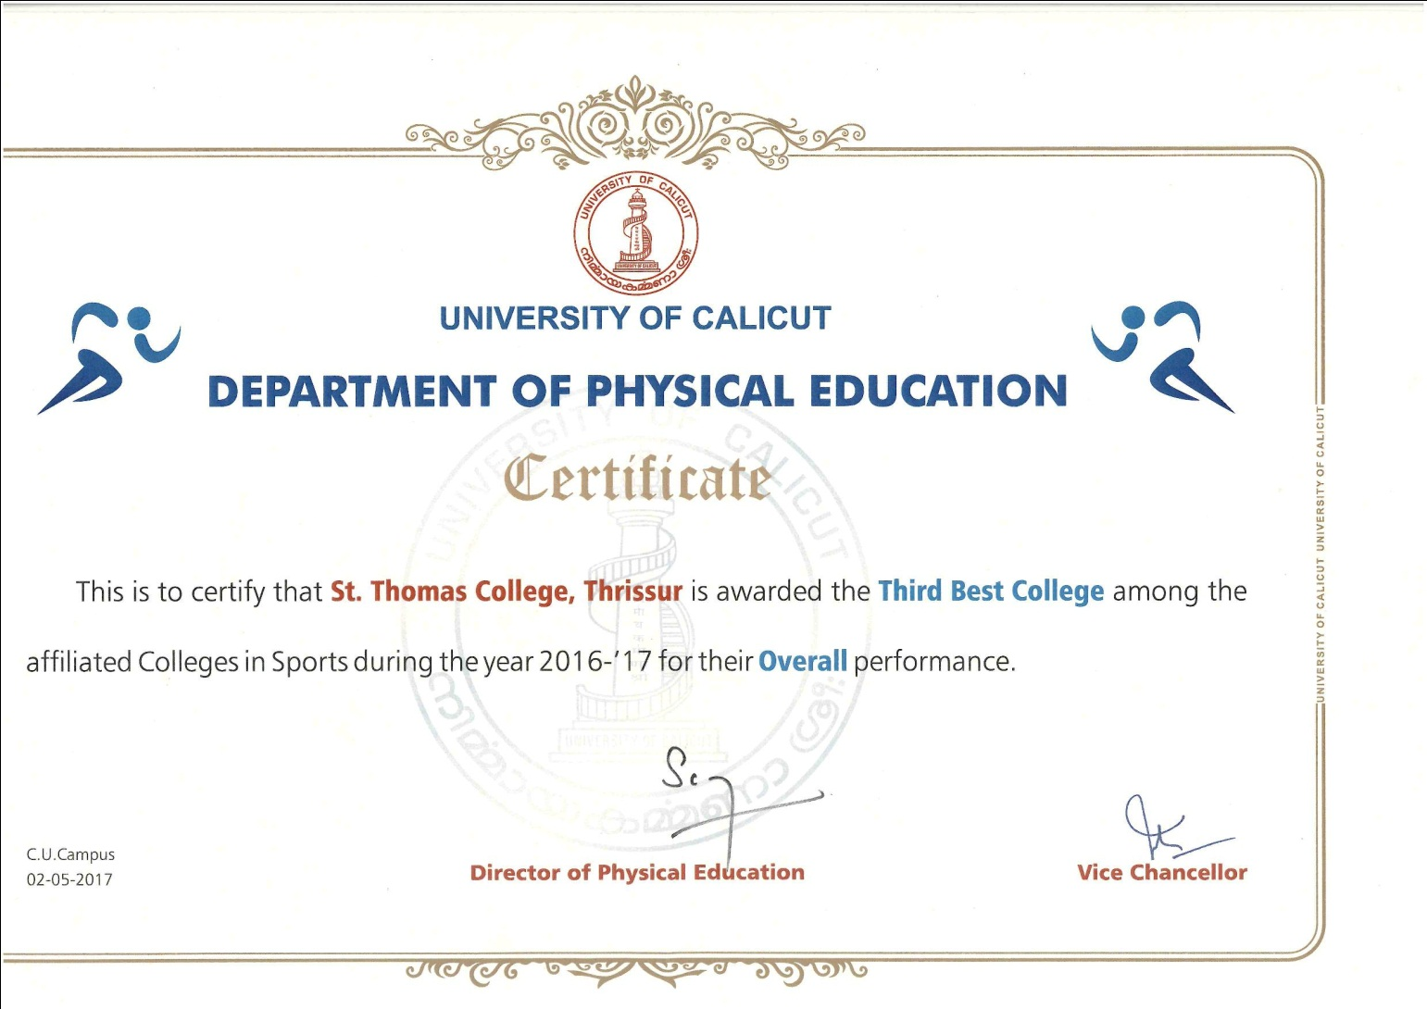
St.Thomas College Awarded the Third Best College Among the Affiliated Colleges in Sports During the Year 2016-17 for the Overall Performance

Slide 3
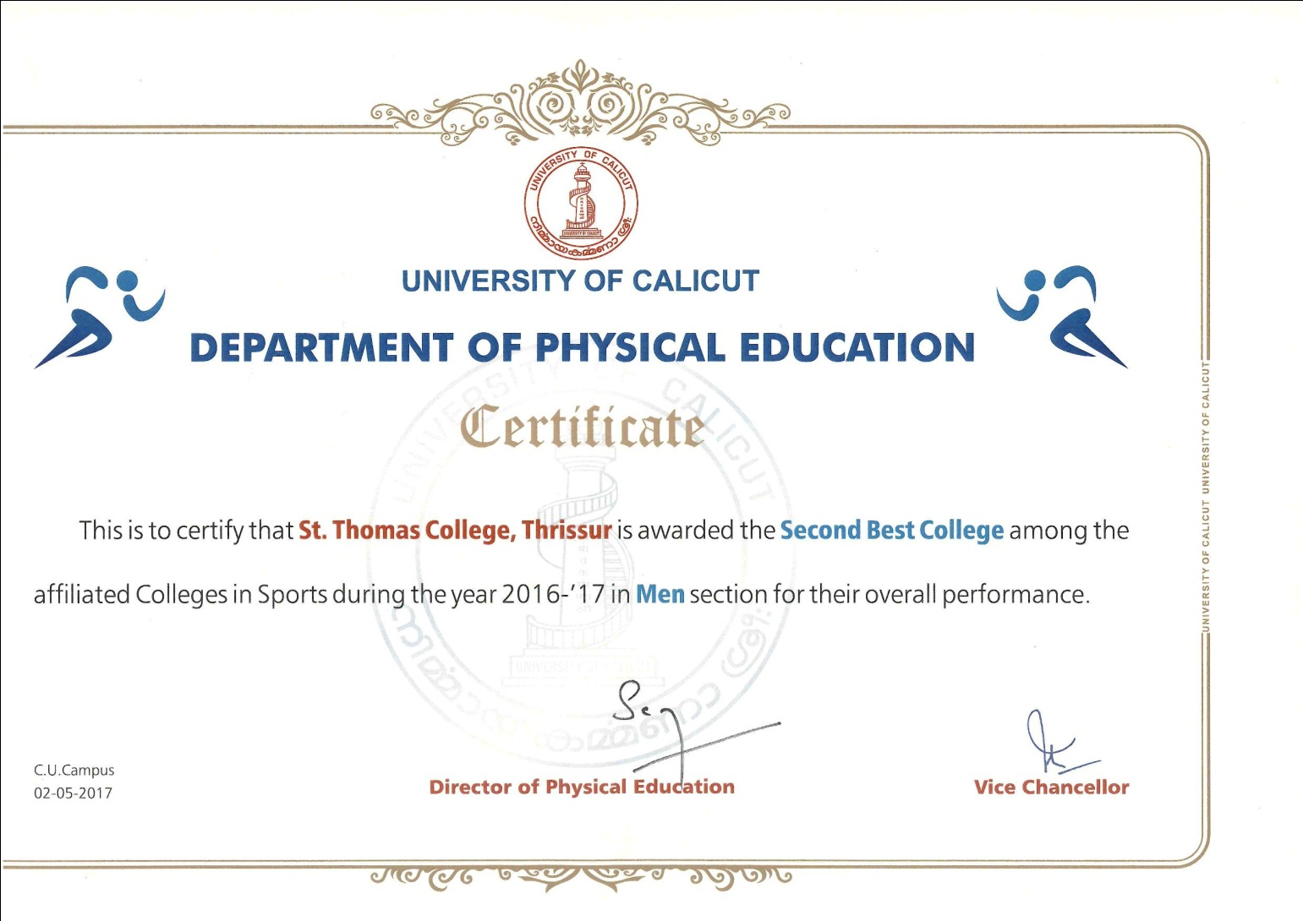
St.Thomas College Awarded the Second Best College Among the Affiliated Colleges in Sports During the Year 2016-17 in Men Section for the Overall Performance

Slide 4
Team Championships 2016-2017
First
1. Swimming
2. Chess (M&W)
3. Cycling
4. Boxing
5. Fencing
6. Hockey
Second
Tennis
Cricket
Water Polo
Power Lifting
Yogasana
Archery - Indian
Second
Weight Lifting
Archery - Compound
D – Zone Champions Men
Foot Ball First

Slide 5
National University (All India) positions 2016-17
Maymon Poulose 110 Meters Hurdles All India IUT Gold
Ashik. A. S Football All India IUT Gold
Anoop.V.C Football All India IUT Gold
Bibin Joy Power Lifting All India IUT 4th
Open National Positions 2016-17
Bibin Joy Power Lifting Junior Nationals held Coimbatore 4th
National participation
Kishor P Xavier Power Lifting - Junior Nationals held Coimbatore
Christopher C J Power Lifting - Unequipped Jr. nationals @ Jammu
Kishor P Xavier Power Lifting - Unequipped Jr. nationals @ Jammu

Slide 6
Swimming - Men - Calicut University Champions 2016-17 Held at Sports Council Swimming Pool, Thrissur 4th and 5th Oct 2016
Vaishnav R.S 1st 100 back Stroke
1st 400 Individual Medley
2nd 200 Individual Medley
2nd 50 back Stroke
3rd 50 Butter fly
1st 4x100 Meters Free Style Relay
Sreerag S 1st 400 Free Style
1st 200 Free Style
1st 4x100 Meters Medley Relay
1st 4x100 Meters Free Style Relay
1st 4x 200 Meters Free Style Relay
Abhijith B S 1st 50 Free Style
2nd 100 Free Style
3rd 400 Free Style
1st 4x100 Meters Free Style Relay
1st 4x 200 Meters Free Style Relay

Slide 7
Subin S 1st 1500 Free style
2nd 200 Butterfly
1st 4x 200 Meters Free Style Relay
Amal V 1st 200 Individual Medley
2nd 400 Individual Medley
1st 4x100 Meters Medley Relay
Dinesh Kumar K 1st 200 Butterfly
2nd 100 Butterfly
Jibin Varghese 2nd 200 Breast Stroke
Adarsh M.S. 2nd 50 Brest Stroke
1st 100 Breast Stroke
Sreejith S.S 2nd 1500 free style
2nd 200 back Stroke
1st 4x100 Meters Medley Relay
Nandu G Nair 1st 50 Brest Stroke
2nd 100 Breast Stroke
Ashwin Gomez 1st 200 breast Stroke
1st 4x100 Meters Medley Relay

Slide 8
Following members represented Calicut University for Swimming Team for All India Intervarsity Swimming Championships held at Panjab University Chandigarh from 16th to 20th October, 2016
Vaishnav R.S
Adarsh M.S.
Sreerag S
Relay Results
4x100 Meters Medley Relay 1st
Sreerag S, Sreejith S.S, Amal V, Ashwin Gomez
4x100 Meters Free Style Relay 1st
Vaishnav R.S, Sreerag S, Abhijith B S, Binu Issac
4x 200 Meters Free Style Relay 1st
Sreerag S, Abhijith B S, Subin S, Binu Issac

Slide 9
Cycling Men - Calicut University Champions 2016-17 Held at St. Thomas College, Thrissur on 13th Feb 2017
RAHUL .T .S 1st 1000 Mts Sprint
JITHU. N. J 1st 1600 Mts Massed Start
VARUN C V 1st 4000 Mts Individual Pursuit 2nd 1000 Mts Sprint
Alex T.F 1st 1000 Mts Time trial
1st 4800 Mts Massed Start
2nd 1600 Mts Massed Start
FRANLAN .C . F 3rd 4800 Mts Massed Start

Slide 10
Team events
1600 Mts Team Time Trial 1st
Rahul T S, Clinton Nixon, Varun C V, Franlan C F
4000Mts Team Pursuit 1st
Jithu N J, Alex TF, Alan George A, Shihas A B
Following members represented Calicut University for Cycling Team for All India Intervarsity Cycling Championships held at Guru Nanak Dev University, Amritsar from 16th – 19th Nov 2016
JITHU. N. J
VARUN C V
FRANLAN .C . F
ALEX T.F

Slide 11
Chess - Men - Calicut University Champions 2016-17 Held at Vidya Academy of Science & Technology, TCR 29th Sep. to 1st Oct., 2016
Sooraj M R
Deepak K S
Syam Peter
Sibin Paul
Rahul Bhaskaran
Jain Jacob P T
Following members represented Calicut University Chess Championships held at Vels Tech, Chennai SZ-8th October, 2016
Deepak K S
Syam Peter

Slide 12
Boxing - Men - Calicut University Champions 2016-17 Held at Christ College, IJK
Jerry Jacob 52-56 Bantam 1st Uty
Akshay Dileep 64-69 Welter 1st Uty
Akhillal Babu 69-75 Middle 1st Uty
Rahul P S 49-52 Fly 1st
Ebin Babu P 75-81 Light heavy 1st
Nishmaldas A D 46-49 Light Fly 2nd
Britto Joseph 91+ Super heavy 3rd
Following members represented Calicut University Boxing Championships held at LPU, Jalandhar ; Jan 2017.
Jerry Jacob 52-56 Bantam
Akshay Dileep 64-69 Welter
Akhillal Babu 69-75 Middle

Slide 13
Fencing - Men - Calicut University Champions 2016-17 At Vimala College, Thrissur
Nidhin Surendran 1st Foil
2nd Epee
Stebin Thomas K 3rd Foil
France Francis 1st Epee
Epee Team event 1st (Nidhin Surendran, France Francis, Basil P Elias, Don Thomas Davy)
Foil Team event 1st (Nidhin Surendran, Basil P Elias, Akash K, Stebin Thomas K)
Sabre Team event 1st (France Francis, Akash K, Don Thomas Davy, Stebin Thomas K)
Following members selected to represent Calicut University Fencing Team for the year 2016-17
Epee Team
Nidhin Surendran
France Francis
Foil Team
Nidhin Surendran
Stebin Thomas K

Slide 14
Hockey Men Champions 2016-17 Held at Govt Victoria College, Palakkad
Mujeeb P M 4th Sem MA English
Bibin Baby 4th M Com
Rahul R 6th sem B Sc Botany
Akhilraj P S 6th Sem BA Economics
Vishnu V V 6th Sem BA Economics
Aswanth K Sajeev 4th sem B Sc Mathematics
Alwin Jacob 4th sem B Sc Mathematics
Alwin Jose 4th sem B Sc Chemistry
Clinto V A 6th sem BA Economics (N+1)
Remesh C R 2nd sem B Com
Rathin O R 6th sem BA Economics (N+1)
Anver A S 2nd sem B Sc Mathematics
Athil Haneef 2nd sem BBA
Ashwanth K 2nd sem B Sc Chemistry
Krishna Prasad 2nd sem B Com
Shafeer P B 2nd sem B A Economics
Illyas M 2nd sem B Sc Statistics
Sajan Sahadevan 2nd sem B Sc Computer Science
Following members represented Calicut University Hockey team 2016-17 for South Zone Intervarsity Championships held at Alagappa 27th Dec., 2016
Mujeeb P M
Bibin Baby
Akhilraj P S
Vishnu V V
Clinto V A
Remesh C R

Slide 15
Cricket - Calicut University Runner – up 2016-17 Held at Victoria College, Palakkad & Finals at Sre Krishna College GUR On 17th March 2017
Sidharth Sankar
Nidhin K
Subin Thomas
Ajmal T Latheef
Clinto V.A
Adithya Mohan
Renik C.M
Arjun K.R
Naveen Joy
Abhiram C H
Vivek K S
Muhammed Ashiq
Amaldev T V
Amal Raju
Abijithkumar V U
Britto V Jose
Following members represented Calicut University Cricket team 2016-17 for South Zone Intervarsity Championships held at Hindustan Tech Cuttack .
Sidharth Sankar
Subin Thomas
Abhiram C H

Slide 16
Water Polo - Calicut University Runner – up 2016-17 Held at Aquatics, Thrissur
Amal V.
Ashwin Gomez
Sreejith S.S
Dinesh Kumar K.
Kannan Soman
Adarsh M.S
Jibin Varghese
Vaishnav R.S
Nandu G.Nair
Binu Issac
Abhijith B.S
Subin S
Sreerag S.
Following members represented Calicut University for water polo Team for All India Intervarsity water polo Championships held at Panjab University Chandigarh from 16th to 20th October, 2016.
Sreerag S
Ashwin Gomez
Nandu G. Nair
Binu Issac
Abhijith B.S
Subin S

Slide 17
Power Lifting - Calicut University Runner – up 2016-17 Held at St. Thomas College, Thrissur on 14th Feb 2017
Bibin Joy II sem BA Economics 66 Kg 1st
Kishor P Xavier II sem BA Economics 120 Kg 1st
Christopher C J IV sem B Sc Mathematics 120+ Kg 2nd
Prajith R G II sem B Sc Statistics 59 Kg 3rd
Following members represented Calicut University Team for All India Intervarsity Power Lifting Championships held Panjab University, Chandigarh Feb 2017
Bibin Joy
Kishor P Xavier
Christopher C J

Slide 18
Tennis - Men - Calicut University Runner – up 2016-17 Held at Christ Vidyanikethan, Irijalakuda .
ALEX SOJAN
RAHUL V
TINO VINCENT
MELWIN THOMAS
SUBIN .P .S
Following members selected to represent Calicut University Tennis Team for the year 2016-17
ALEX SOJAN

Slide 19
Archery Held at Christ College, IJK 21st Jan 2017
Indian round team Second
ALEX PALLAN
EMMANUEL JOHNSON
RANOOSH V R
AJAY. K. P
Compound round Third
JIMSON C.P
Tino Vincent
Joseph Edward Edison

Slide 20
Yogasana - Men - Calicut University Runner – up 2016-17 Held at Vidya Academy of Science and Technology, Thrissur
SAGAR K P
VIJITH V.
VISHNU VIJAYAN
Abijith K
Alex Jerom M
VIVEK P.K
Following members represented Calicut University Yogasana Championships held Kurukshetra University, Kurukshetra, Haryana, India, March 2017
SAGAR K P
Sagar. K P
Alex Jerom
Vishnu Vijayan

Slide 21
Weight Lifting - Calicut University Team Third 2016-17
Prajith R G I B Sc Statistics 1st 56Kg
Rahul P G III B Sc Mathematics 2nd 69Kg
Roni Johnson II B Sc Botany 2nd 85Kg
Adhish V Thankachan III B Sc Zoology 3rd 94Kg
Wilmin Wilson III BA Eng & Hist 3rd 62Kg
Christopher C J III B Sc Mathematics 3rd 105+ Kg

Slide 22
Chess - Women - Calicut University Champions 2016-17 Held at Vidya Academy of Science & Technology, TCR 29th Sep. to 1st Oct., 2016
Nidhisha M Mohanan
Johnlin C Johnson
Choondal Alfred Deepthi
Sarayu Sidharthan V
Stenna Sebastian
Judit Vincent
Following members represented Calicut University Chess Women Tem for South Zone Intervarsity Chess Championships held at Vels Tech, Chennai SZ-8th October, 2016
Nidhisha M.Mohanan
Choondal Alfred Deepthi
Johnlin C Johnson
Individual Champion
Nidhisha M.Mohanan

