Slide 1
ST. THOMAS’ (Autonomous) COLLEGE Thrissur
DEPARTMENT OF PHYSICAL EDUCATION
ACHIVEMENTS 2015-16

Slide 2
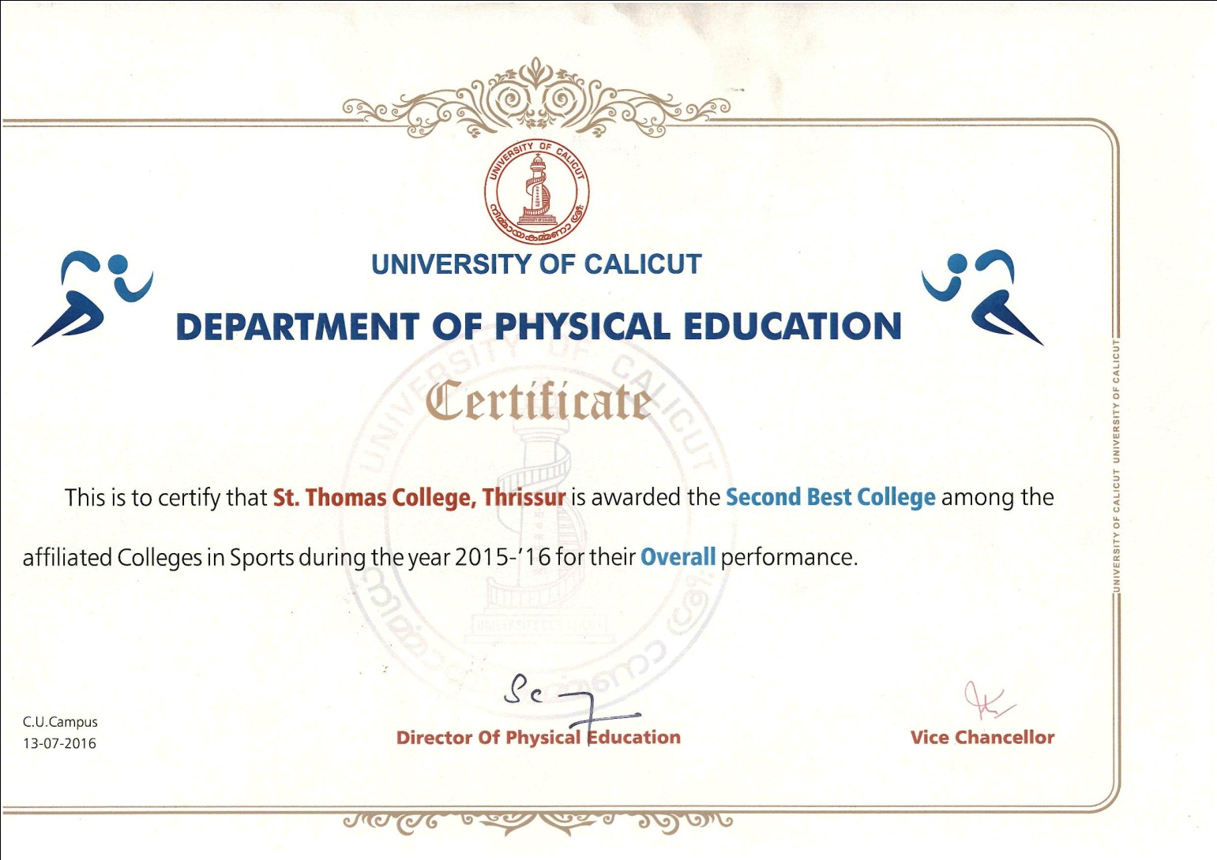
St.Thomas College Awarded the Second Best College Among the Affiliated Colleges in Sports During the Year 2015-16 for the Overall Performance

Slide 3
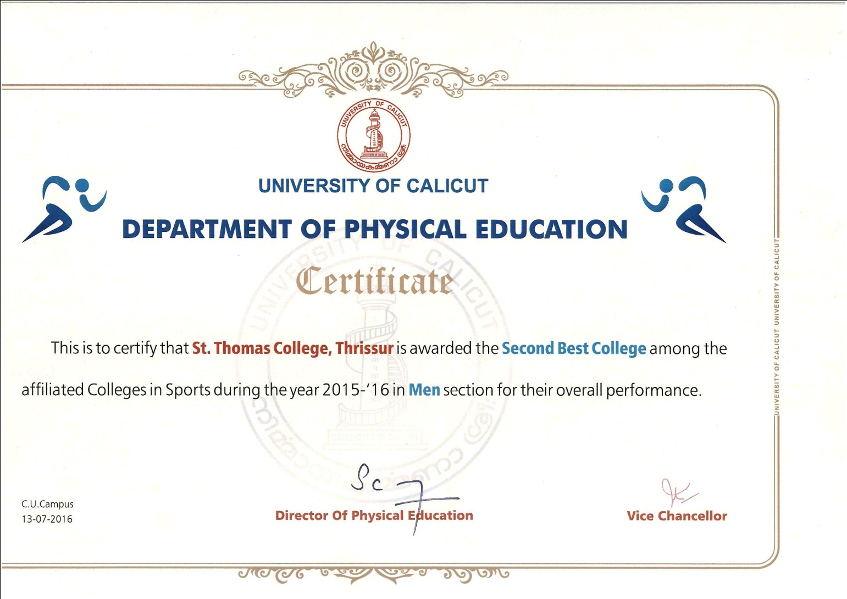
St.Thomas College Awarded the Second Best College Among the Affiliated Colleges in Sports During the Year 2015-16 in Men Section for the Overall Performance

Slide 4
Team Championships 2015-2016
First
Swimming
Water Polo
Cycling
Boxing
Hockey
Fencing
Yogasana (M)
Chess ( Men & Women )
Archery - Compound
Second
Cricket
Yogasana (W)
Third
Archery- Indian Round

Slide 5
National level winners
Following students from this college Represented University in South Zone Intervarsity Championships in Football, held at Amrita University Coimbatore secured Second and the same team secured Third In All India Intervarsity Was Held At Noida, Uttar Pradesh
Ashik A S II BA English & History
Nasar P A I BA Economics
Anoop V.C III BA Economics

Slide 6
Water polo- All India Intervarsity - 4th
Following students from this college Represented Calicut University in All India Intervarsity Water Polo Championships held at Panjab University, Chandigarh, secured fourth
Aswin Gomez III B Sc Chemistry
Sreerag S I BA English & History
Sreejith G I BA English & History
Rahul A Nair II BA English & History
Abhijith B S I BA Economics

Slide 7
Swimming Calicut University Champions 2015-16 Held at Vimala College Swimming Pool from Sept 30 – 1st Oct 2015
Sreerag S I BA English & History 400 Free Style 1st
100 Free style 1st
200 Free style 1st
Abhijith B S I BA Economics 200 Individual Medley 1st
1500 Free style 1st
400 Individual Medley 3rd
400 free style 3rd
Binu Issac III BA English & History 100 Back stroke 1st
200 Back stroke 1st
200 Free style 2nd
50 Back stroke 2nd
Sreejith G I BA English & History 50 Free style 1st
50 Butterfly 1st
50 Back stroke 1st
100 Butter Fly 3rd
100 Back stroke 3rd
Ashwin Gomez III B Sc Chemistry 200 Brest Stroke 1st
100 Brest stroke 1st
50 Brest strike 2nd

Slide 8
Nandu G Nair III BA English & History 50 Brest stroke 1st
100 Brest stroke 2nd
200 Brest stroke 2nd
50 Butterfly 3rd
Ranjith R II BA English & History 100 Free style 2nd
50 Free style 2nd
Amal V I BA Economics 400 Individual Medley 1st
200 Individual Medley 2nd
200 Butter Fly 2nd
100 Butter Fly 2nd
Subin S I BA Economics 200 Butter Fly 3rd
1500 Free 3rd

Slide 9
Swimming - Relay events
4 x 200 Free Style Relay 1st
Binu Issac,
Sreerag S
Abhijith B S,
Amal V
4 x 100 Medley Relay 1st
Binu Issac,
Ashwin Gomez,
Sreerag,
Amal V
4 x 100 Free Style Relay 1st
Abhijith B S
Ranjith R
Sreerag S
Binu Issac
Following student selected to represent Calicut University Team in swimming 2015-16
Nandu G Nair
Ranjith R

Slide 10
Cycling Men Calicut University Champions 2015-16 Held at St. Thomas College, Thrissur on 30th Oct 2015
Rahul T S I M Sc Statistics 1st 1000 Mts Sprint 14.66 sec
1st 1000 Mts time Trial 1:29.52 sec
3rd 1600 Mts Massed Start N/A
Varun C V III B Sc Maths 1st 1600 Mts Massed Start N/A
2nd 1000 Mts Sprint 14.90 sec
2nd 1000 Mts time Trial 1:32.52 sec
Jithu N J I M Sc Zoology 1st 4000 Mts Indi.Pursuit 6: 51.57 sec
2nd 4800 Mts Massed Start N/A
Akash PriyanII B Sc Chemistry 1st 4800 Mts Massed Start N/A
2nd 4000 Mts Indi. Pursuit 6: 57.01 sec
Franlan C F III B Sc Com. Sc 2nd 1600 Mts Massed Start N/A

Slide 11
Team events
1600 Mts Team Time Trial 1st 2: 27.20 Sec
Rahul T S
Jithu N J
Varun C V
Franlan C F
4000Mts Team Pursuit 1st 6: 47.70 sec
Rahul T S
Shijin Shoby
Clinton Nixon
Akash Priyan
Following students’ selected to represent Calicut University Team in Cycling 2015-16
Rahul T S I M Sc Statistics
Varun C V III B Sc Maths
Jithu N J I M Sc Zoology
Akash Priyan II B Sc Chemistry

Slide 12
Boxing Men Calicut University Champions 2015-16 Held at St. Thomas College indoor stadium, Thrissur on 28th and 29th Oct 2015
Ayyappadas Mohanan Fly 49-52kg first
Haren M S Bantom 52-56 Kg third
Nithin T T Light 56-60 kg First
Shone Paul Light welter 60-64 second
Dineep Divakaran welter 64-69 first
Nandagopan K light Heavy 75-81 first
Britto Joseph super Heavy 91+ first
Following students’ selected to represent Calicut University Team in Boxing 2015-16
Dineep Divakaran
Britto Joseph

Slide 13
Hockey Men Calicut University Champions 2015-16 Held at Govt Engg College, Thrissur 10th and 11th Dec 2015
Clinto V A III BA Economics
Mujeeb P M I MA English
Vishnu V V II BA Economics
Bibin Baby I M Com
Anoop K.R III BA Economics
Midhun Vishnu C M III BA English & History
Shahir M S II B Sc Physics
Rathin O R III BA Economics
Nikhil T R III BA Economics
Melvin Peter III B Sc Electronics
Rakesh T N II BA Economics
Chandradas S II B Sc Mathematics
Rahul R. II B Sc Botany
Akhilraj P II BA Economics
Aravind C II B Com Banking
Aswanth K Sajeev I B Sc Maths
Alwin Jacob I B Sc Maths
Alwin Jose I B Sc Chemistry
Calicut University Team Members selected to participate for south Zone Intervarsity Hockey Men for the year 2015-16.
Clinto V A
Mujeeb P M
Vishnu V V
Bibin Baby
Anoop K.R
Midhun Vishnu C
Shahir M S

Slide 14
Archery Men Calicut University Champions 2015-16 Held at Christ College, Irijalakuda 16th and 17th Dec 2015
Compound Round team 1st
ALEX A T III B Sc Physics N+1
JOSEPH EDWARD EDISON I BMMC
ALPHIN P.J III BBA
TINO VINCENT III BBA
Indian round Team 3rd
GEO KURIAN E.V III B Sc Computer Science
JOSEPH EDWARD EDISON I BMMC
MIDHUN BABU K II BA English & History
RANOOSH V R I BMMC
Compound Individual Champion
ALEX A T III B Sc Physics N+1
Calicut University Team Members participated for All India Intervarsity Archery Compound Rounds Championships held Punjabi University, Patiala, Punjab
ALEX A T III B Sc Physics N+1

Slide 15
Chess - Calicut University Champions 2015-16 Held at SNDPYSS College, Perintalmanna Sept 29 - Oct 01, 2015
Ramkumar S. 3rd year B com finance
Sooraj M R 1st B com Finance
Mekha M.S 3rd year BA English & History - Team Captain
Rahul Bhaskaran 2nd year BA English & History
Nidhisha M.Mohanan 2nd b Sc Mathematics
Jain Jacob P T 1st M Sc Physics
Following students of this college Represented University for South Zone Intervarsity Championships held at Amrita University Chennai
Ramkumar S.
Sooraj M R

Slide 16
Fencing Men Calicut University Champions 2015-16 Held at Vimala College, under the auspicious of Sre Kerala Varma College on 08th Dec 2015
Following student of this college Represented University for All India Intervarsity Championships in Fencing held at Punjabi University Chandigarh from 11 – 14 Feb 2016
Nidhin Surendran
Fencing – Sabre Team 1ST
France Francis I B Sc Physics
Stebin Thomas K I B Com Banking
Rahul P III B Com Finance
Don Thomas Davy I B Sc Electronics
Fencing – Foil Team 1ST
Basil P Elias II BMMC
Nidhin Surendran I B Com Banking
Stebin Thomas K I B Com Banking
Don Thomas Davy I B Sc Electronics
Fencing – Epee Team 2nd
Basil P Elias II BMMC
Nidhin Surendran I B Com Banking
France Francis I B Sc Physics
Rahul P III B com Finance
Individual positions
Nidhin Surendran I B Com Banking Epee 2nd
Nidhin Surendran I B Com Banking Foil 3rd
Stebin Thomas K I B Com Banking Sabre 2nd

Slide 17
Yogasana Men Team University champions 2015-16 Held at Vimala College, Thrissur on 06th Feb 2016
SAGAR K P 1st B Com
VISHNU VIJAYAN Final B sc Mathematics
VIJITH V.P Final B Sc Chemistry
RISO P TOMY Final B Sc Botany
ALWIN SUNNY Final M Sc Maths
VIVEK P.K Final B Sc Chemistry
Individual Champion RISO P TOMY
Following students from this college represented Calicut University Yogasana Men Team participated for All India Intervarsity Yogasana Championships Chaudhary Ranbir Singh University, Jind, Haryana from 21st to 24th March 2016.
SAGAR K P
VISHNU VIJAYAN
VIJITH V.P
RISO P TOMY

Slide 18
Cricket Men Calicut University Runner up 2015-16 Held at SKVC 15th Dec, 29th 31st and finals on 04th Jan 2016
Subin Thomas 3rd B Sc Computer Captain
Ajmal T Latheef 3rd B Sc Maths
Clinto V.A 3rd B A Eco
Adithya Mohan 2nd BBA
Renik C.M 2nd B com
Arjun K.R 2nd B Com
Naveen Joy 3rd B sc Statistics
Abhiram C H 1st B Com Finance
Vivek K S 1st BA Economics
Muhammed Ashiq 1st BBA
Akhil Chandrabose 2nd B Com banking
Abijithkumar V U 1st BA English & history
Midhun P P 3rd B Sc Maths
Britto V Jose 2nd BBA
Amaldev T V 1st BBA
Rahul C 2nd B Sc Maths
Calicut University Team Members participated for South Zone Intervarsity Cricket Championships held Chennai
Clinto V.A
Abhiram C H

Slide 19
Water polo Calicut University Runner-up 2015-16 Held at Vimala College Swimming Pool from sept 30 – 1st Oct 2015
Abhijith B S 1st year BA Economics
Nandu G Nair 3rd year BA English & History
Binu Issac 3rd year BA English & History
Subin S 1st year B Sc Botany
Ananthu G S 1st B Sc Statistics
Ashwin Gomez 3rd B Sc Chemistry
Amal V 1st year BA Economics
Sreerag S 1st year BA English & History
Sreejith G 1st year BA English & History
Ranjith R 3rd year BA English & History
Rahul A Nair 2nd year BA English & History
Subin P S 1st year BA Economics
Adithya Sagar E S 3rd year B Com - Self
Water polo: - Following students of this college Represented University for All India Intervarsity water polo Championships held at Panjab University Chandigarh
Aswin Gomez
Sreerag S
Sreejith G
Rahul A Nair
Abhijith B S

Slide 20
Athletics Held at Calicut Medical College stadium on 2,3,4 Dec 2015
Karthik K III BA English & History(N+1) 1st 400 Mts Hurdles
Abdussamed A M II B Com 2nd 100 Mts
Ajith K R II M Sc Physics 3rd 100 Mts
Bibin P S III BA English & History 3rd 10000 Mts
Sneha Raj Alappat II M.A Economics 2nd Long Jump
4 x 100 Relay 3rd (Abdussamed, Karthik K, Sooryanarayan V S, Akash P P)
Represented University - All India Intervarsity Championships in Athletics held at Punjabi University Chandigarh
Karthik K III BA English & History (N+1)
Abdussamed A M II B Com
Ajith K R II M Sc Physics

Slide 21
Weight lifting Held at Vimala College Indoor Stadium Thrissur on 14th 15th Dec 2015
ADHISH V THANKACHAN III B Sc Zoology 105 2nd
VISNHU E A III BBA 105Kg 3rd
RAHUL P G II B Sc Maths 69Kg 3rd
Power lifting
Held at ZGC Calicut on 01st and 02nd Jan 2015
Ajith V J 1st 93Kg, total Wt. 715Kg I MVC
Kishore P Xavier 2nd 105 Kg total 627.50 Kg I BA Economics
Rohan Jose 3rd 66 Kg total 477.50 Final B Com
Vishnu E A 3rd 105 Kg total II BBA
Following students for this college participated Calicut University Team for All India Intervarsity Power Lifting Championships held Guntur Andhra Pradesh, January 2016
Ajith V J
Kishore P Xavier

Slide 22
Best Physique Held at Sre Krishna College Guruvayur 29th Dec 2015
Prince M D 60Kg 1st II MA Economics
Following student of this college represented for Calicut University Team participated for All India Intervarsity Best Physique Championships held Guntur Andhra Pradesh, January 2016
Prince M D
Kalaripayattu
Abhijth V G BSc Physics 2nd ( Edathu chavitti/ valamthiri malarnnuchadal)
Yogasana Women Team University Runner up 2015-16
Held at Vimala College, Thrissur on 06th Feb 2016
ALEENA ANNA GEORGE Final B Com
ANJU C S Final B Sc Botany
ASWATHY K D Final B Sc Botany
SUSMIYA SURESH Final B Sc Botany
CHINJU MARIA RAJU Second B Sc Statistics
AKHILA BENNICHAN Second B Com
Following student from this college represented Calicut University Yogasana Women Team participated for All India Intervarsity Yogasana Championships Chaudhary Ranbir Singh University, Jind, Haryana from 21st to 24th March 2016
ALEENA ANNA GEORGE

